Slide 1
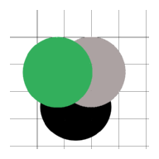
Don’t Drop That
EK327
Adam Surette, Duruvan Saravanan
Zhen “Isabelle” Yang, Qingru “Mirah” Xu

Slide 2
Introduction
Don’t Drop That is a physics based game
The objective is simple : tilt the screen to move the ball and avoid all holes
Try to survive as long as you can!

Slide 3
Objectives
The motivation to create this game came from the fact that the best games in the app market take a minute to understand but a lifetime to master
We also wanted the game to be interactive and absorbing - hence the tilt screen mechanics
We envisioned the game as a fun way to take a small break from work or study (although, we don’t mind our users playing it for hours!)

Slide 4
Game Flow-chart
Activity Starts
Load welcome screen
Score Screen
Exit
Wait for user input
Wait for user input
Play until fail condition met
Popup
Restart Button
Get data based on phone tilt
Version
Screen
Start new activity
Play the game

Slide 5
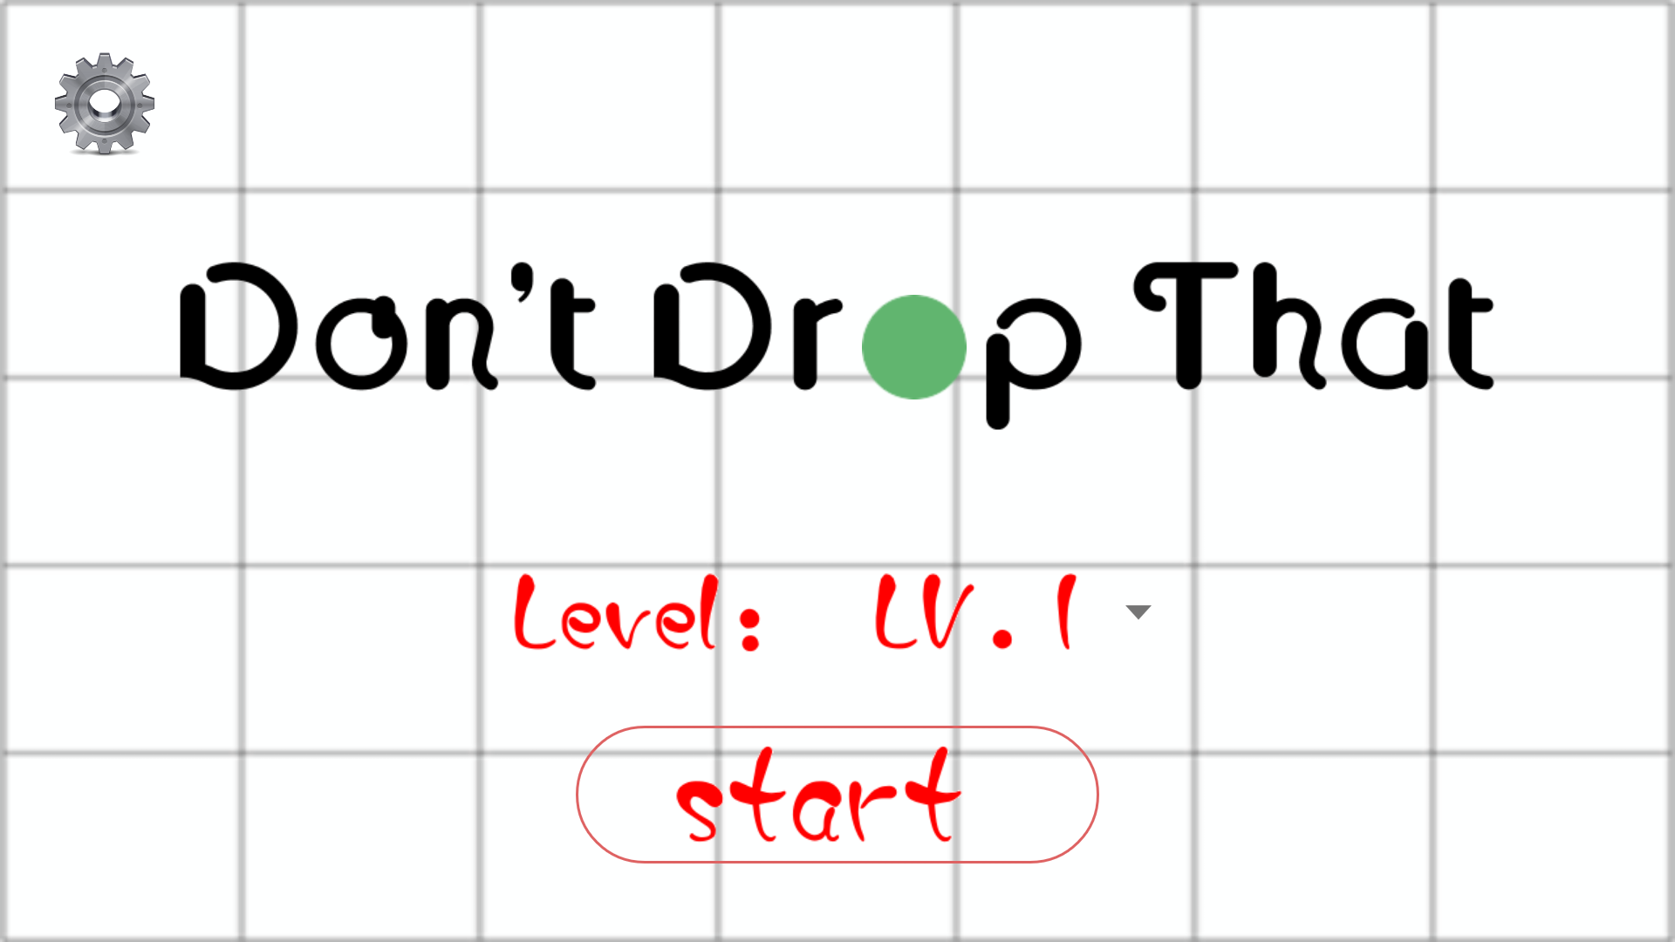
Start Screen
The start screen in the first layout that the user encounters when they start the app.
It consists of three buttons, a start button, a score page button, and level scroller.
The play button starts the game and the score page button allows the user to view their scores.

Slide 6
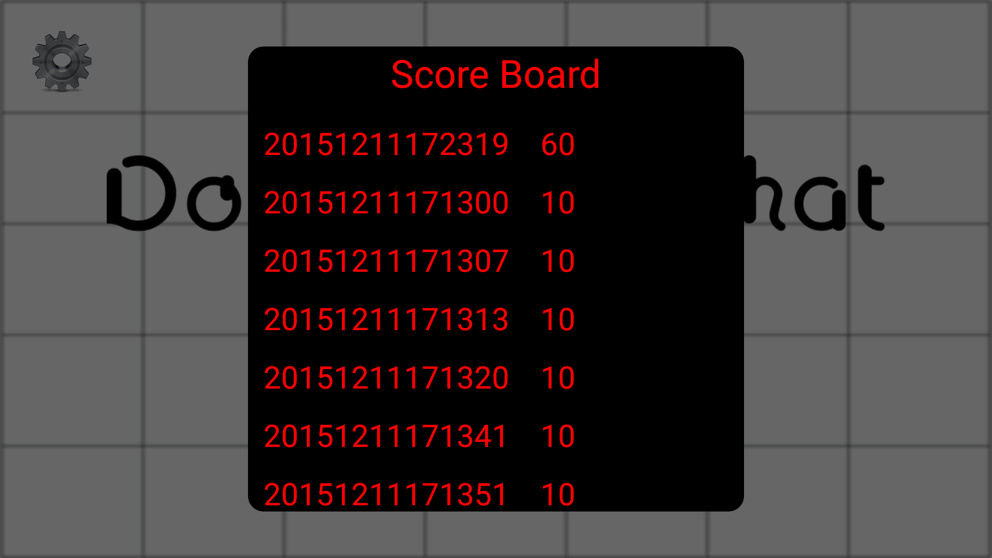
Score Page
The score page allows the user to view the various scores they have achieved in the game.
The scoreboard were implemented using adapter class, which calls the time of the score and the value of the score.

Slide 7
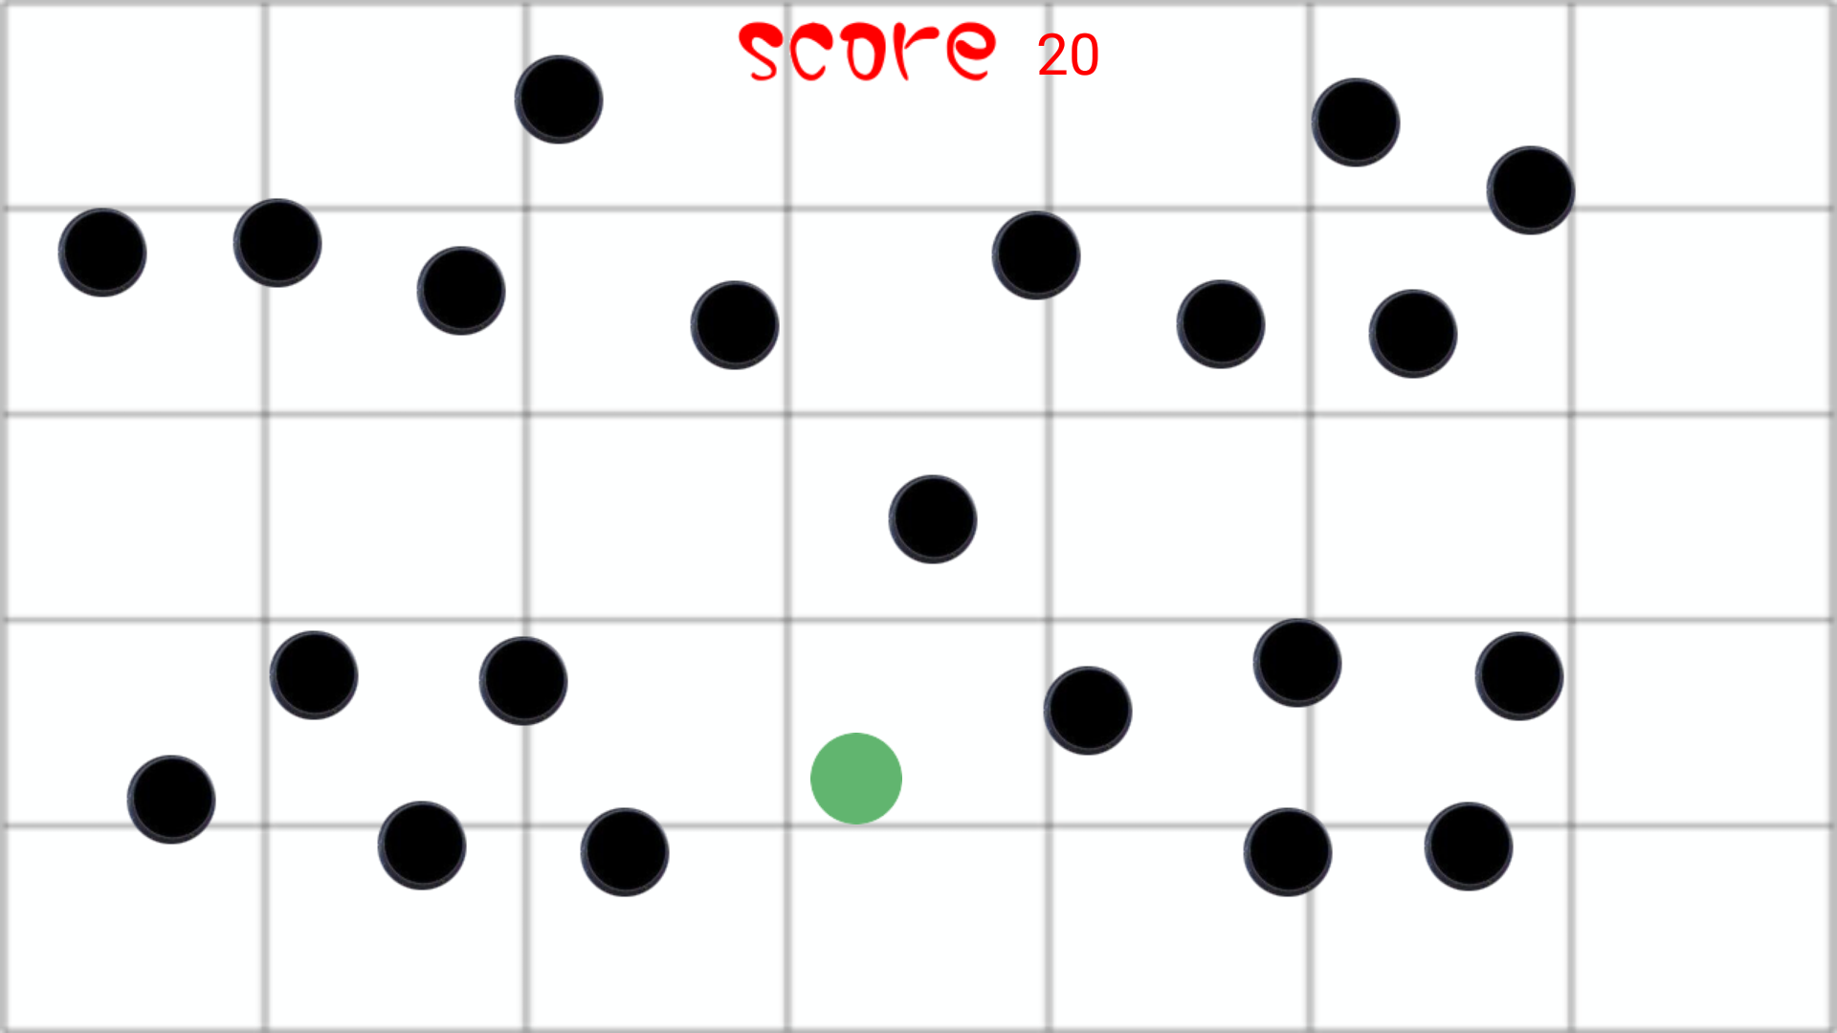
Play
This is the main layout of the game. It consists of two main components: the ball and the holes.
The ball can be controlled by the user by simply tilting the screen.
The holes are controlled internally and spawn at random locations on the screen. They change positions every 3 seconds.
The current score is also displayed at the top of the screen.

Slide 8
The ball The holes
The ball is the main object of the game. It moves in the direction that the user tilts their phone in.
The algorithm to create the ball is contained in BallView which is a class. The class is called in the main function.
The class accepts 4 parameters. The color is set to green.
The holes are the other objects in the game. The instructions for the view is contained in HoleView.
The HoleView class is called in GamePage and then the holes are created.
The instructions for the co-ordinates of the holes are contained in another dedicated class called HoleCoordinate.

Slide 9
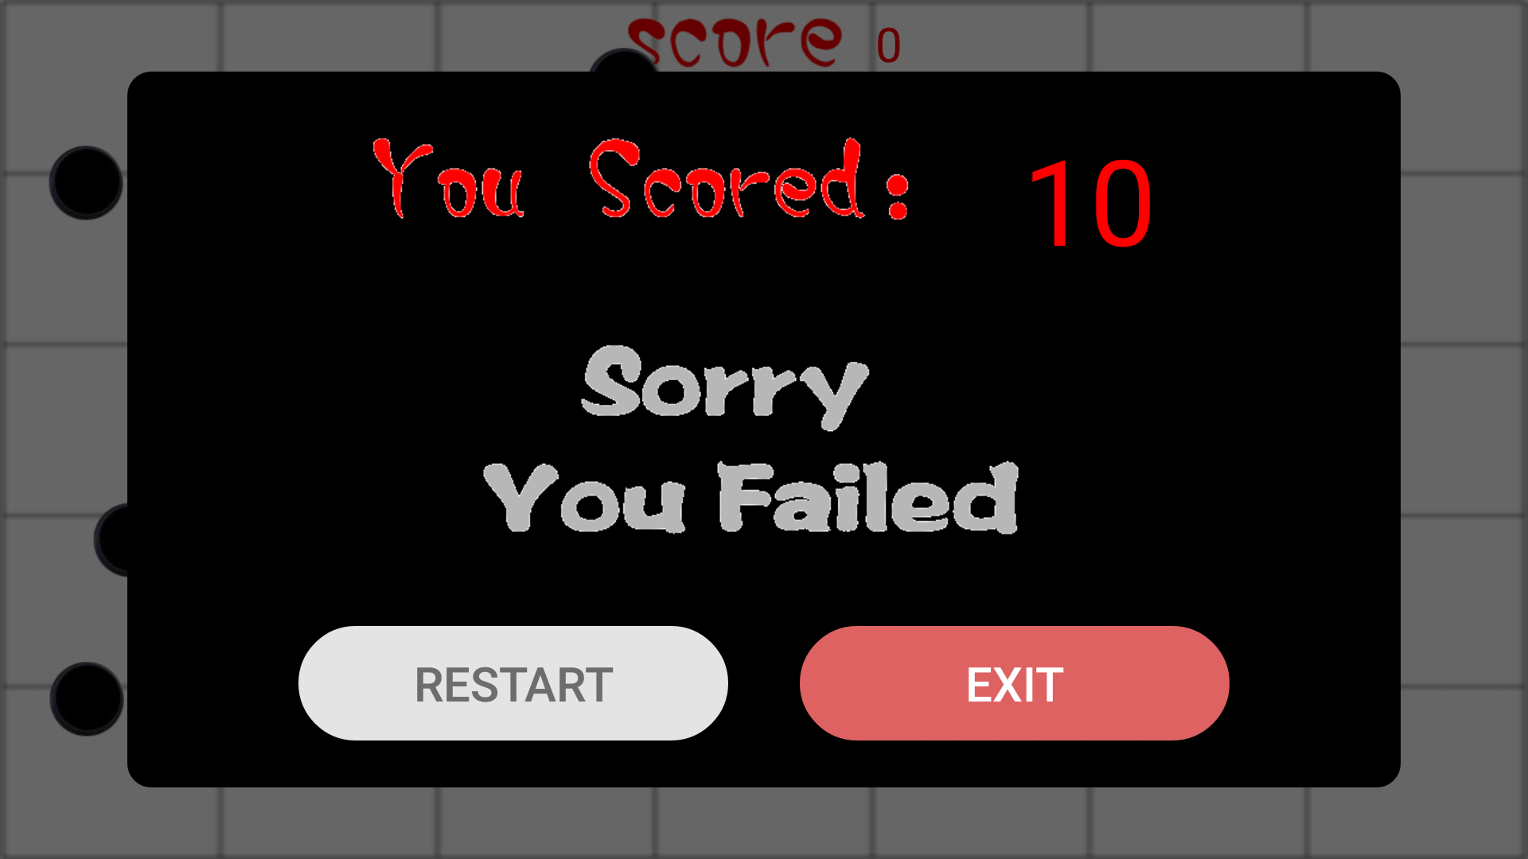
Game Over
The game over pop is displayed after the ball has fall into a hole.
If the newest score beats the highest score, it will show a “congratulations” message. If the score is lower than the high score, a “sorry” message is displayed.
The score was implemented by the UserData java file and called in the main java file after the failing condition has met. The score is the timer’s second multiplied by 10.

Slide 10
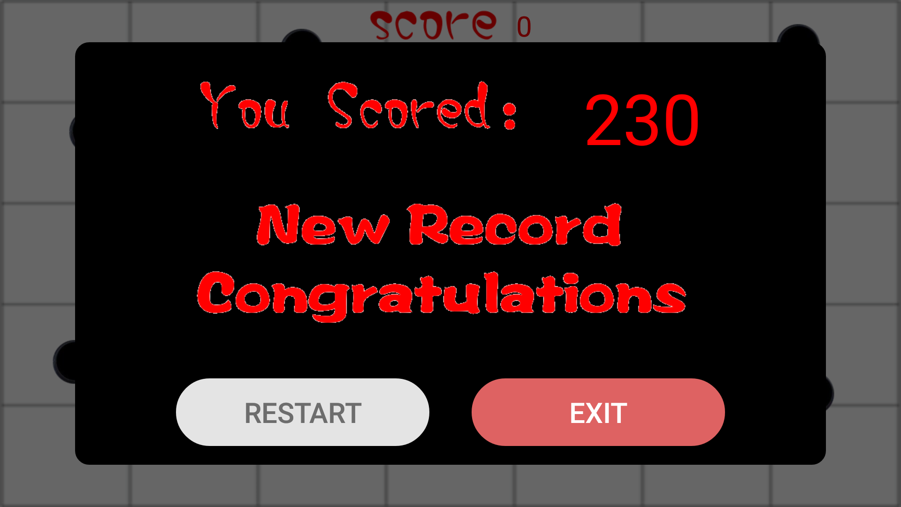
Game Over
At the bottom of the pop-up there is a “restart” and an “exit” button.
If the “restart” is clicked, the user will be taken to the start of the play screen. If “exit” is clicked, the user will be taken to the start screen.
Both buttons were created in the main java file and linked to different pages by the OnClickListener method.

